Slide 1
CRAFTING
WELL-DESIGNED SITES
Design for the front-end web dev in all of us

Slide 2
Self Introduction
Definition of Design
Why We Should Design
Some Examples
What Makes Good Design
How To Start

Slide 3
I have a confession to make
I’m an Art major
But I can’t draw
So am I an artist?
Eh, probably not
And so can you!
But I can make well-crafted websites

Slide 4
Self Introduction
Definition of Design
Why We Should Design
Some Examples
What Makes Good Design
How To Start

Slide 5
Design (n.)
a plan or drawing produced to show the look and function or workings of a building, garment, or other object before it is built or made.

Slide 6
Web Design (n.)
a plan or drawing produced to show the look and function or workings of a website before it is built or made.
a plan or drawing produced to show the look and function or workings of a website before it is built or made.

Slide 7


Slide 8
Self Introduction
Definition of Design
Why We Should Design
Some Examples
What Makes Good Design
How To Start

Slide 9



Slide 10
Does this look good?
Is this readable?
Is this organized?
Does the organization & layout contribute to my message?

Slide 11
Self Introduction
Definition of Design
Why We Should Design
Some Examples
What Makes Good Design
How To Start

Slide 12
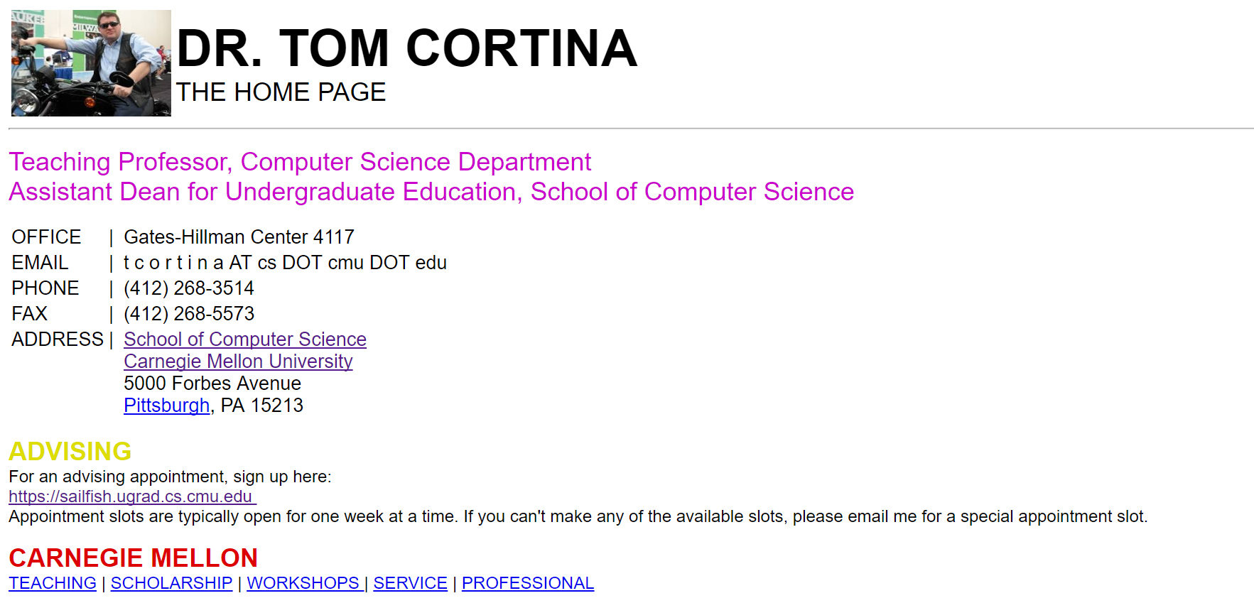

Slide 13
What’s Wrong?
Clashing colors
Uses default headers
No indentations
Solid white background
Solid black text
Small self-portrait
Very empty overall

Slide 14
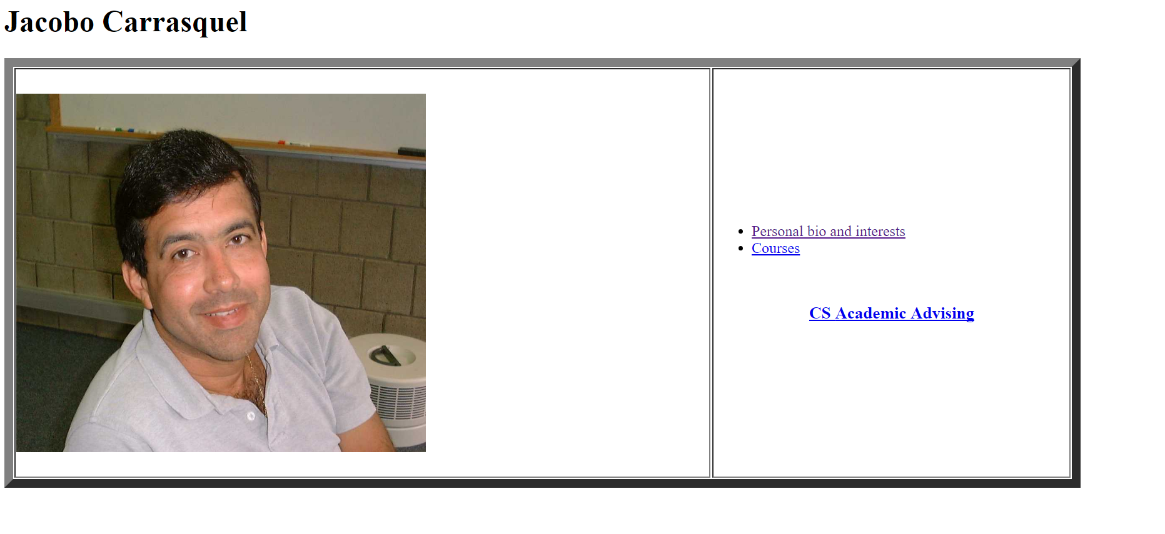

Slide 15
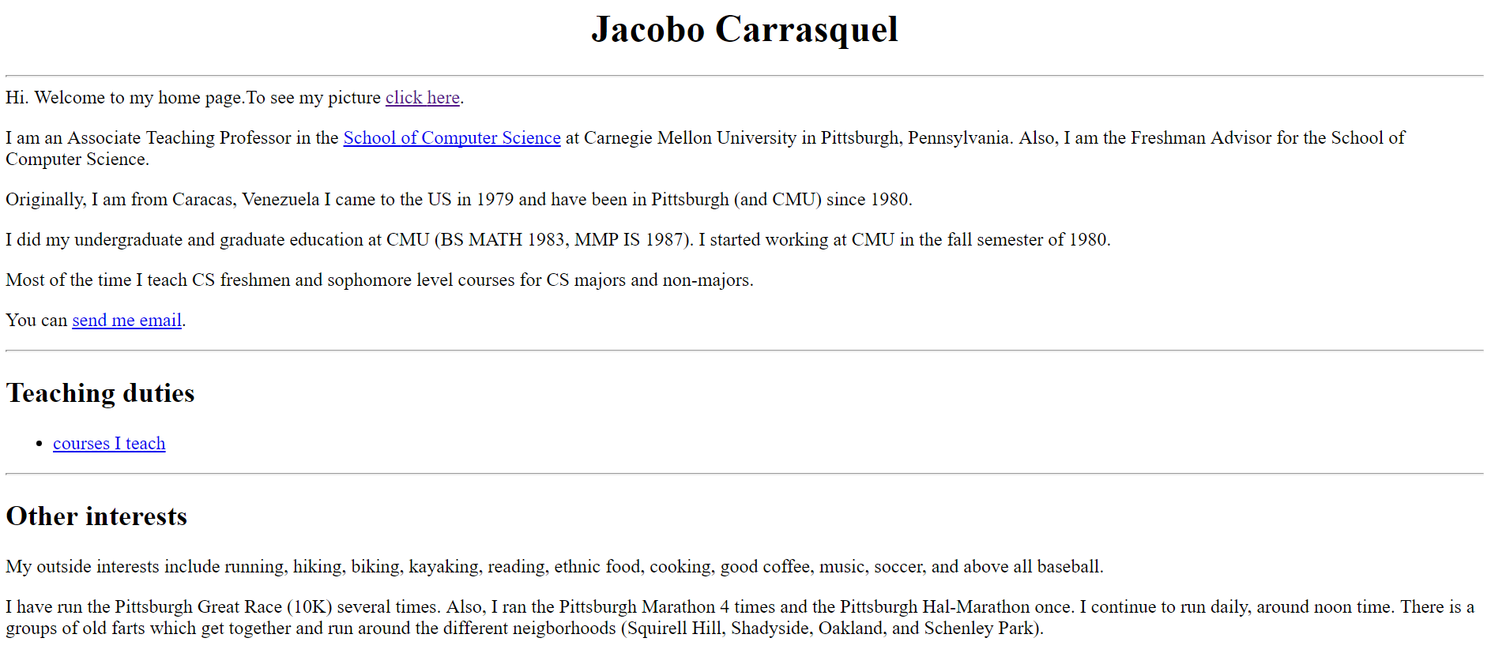

Slide 16
What’s Wrong?
You know what’s wrong

Slide 17
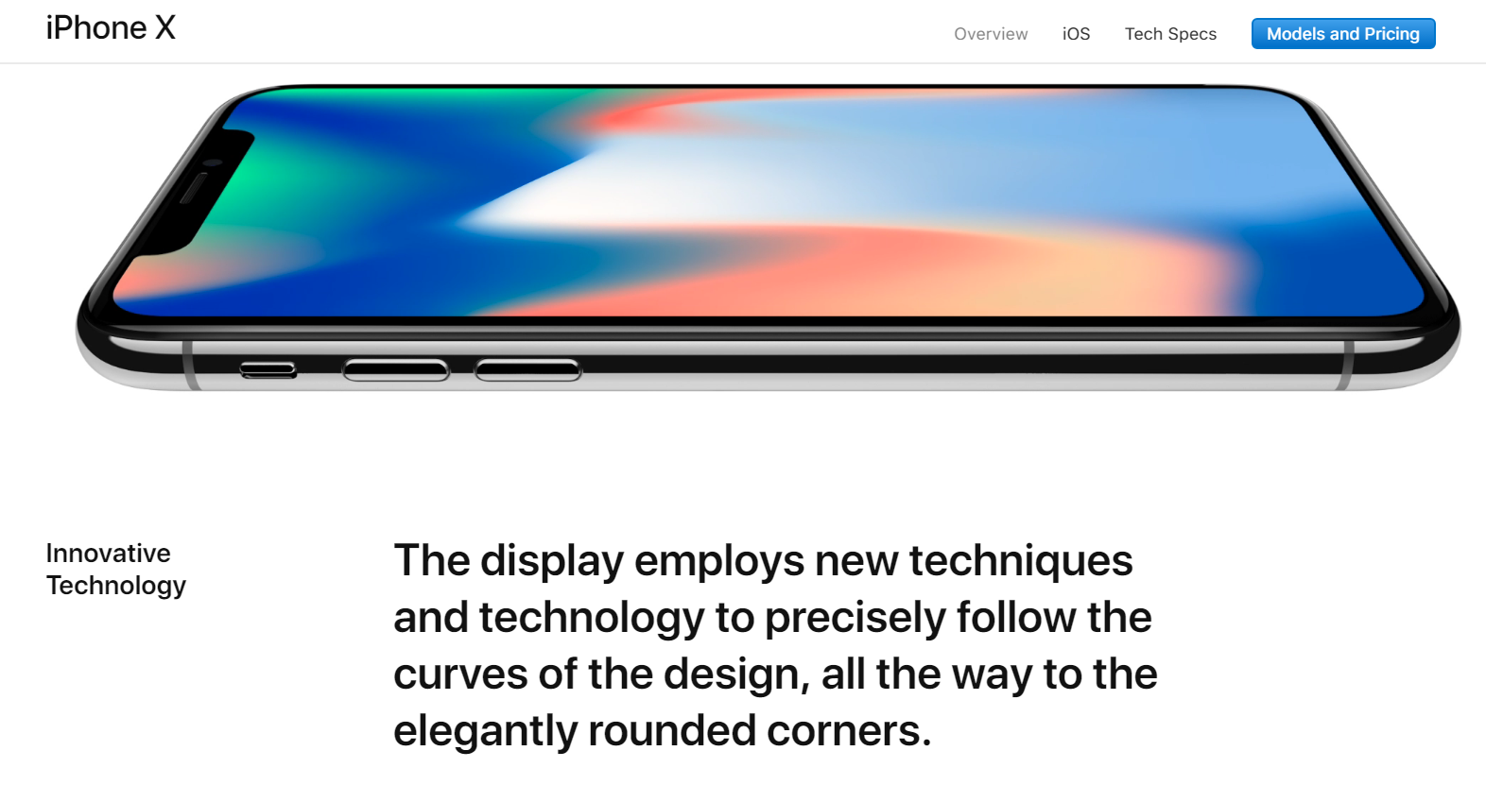

Slide 18
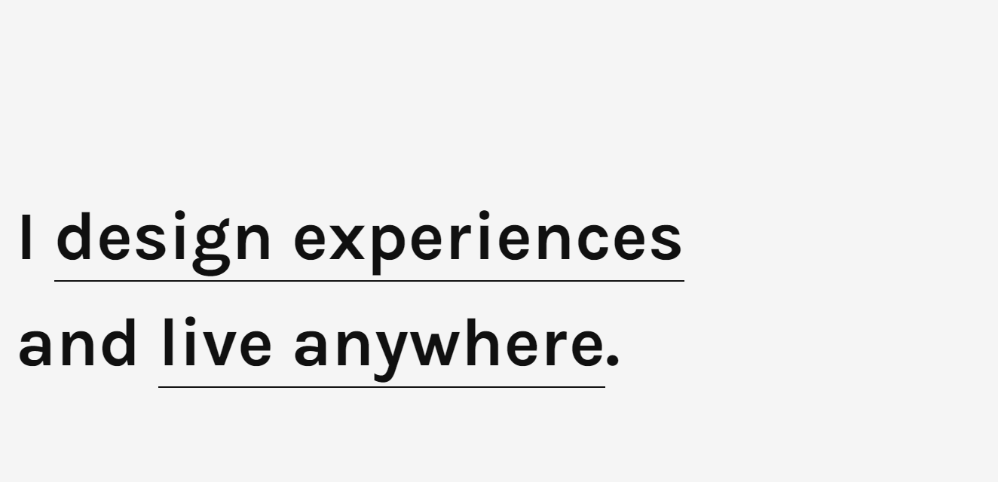
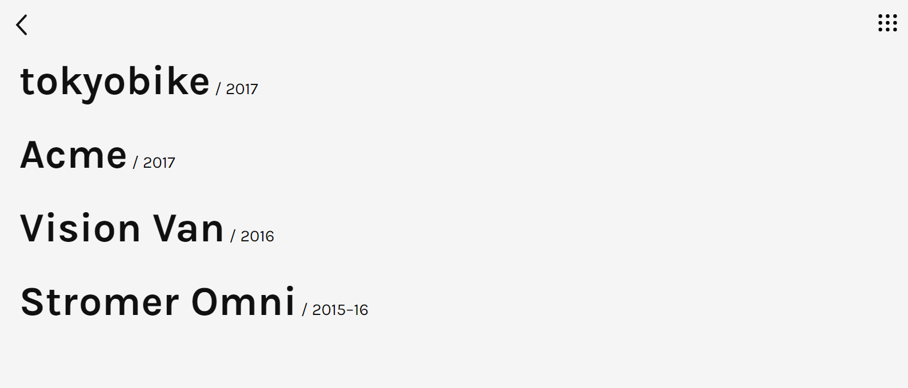
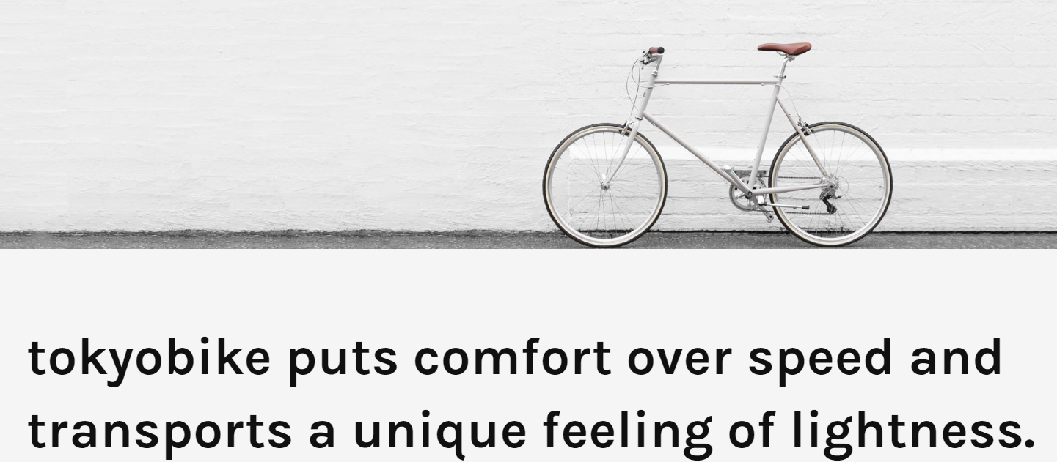
Credits
https://simon.works/

Slide 19
Self Introduction
Definition of Design
Why We Should Design
Some Examples
What Makes Good Design
How To Start

Slide 20


Slide 21
Quantity does not imply Quality
Less is more
“Is this relevant to my website?”
Inform, don’t brag

Slide 22



Slide 23
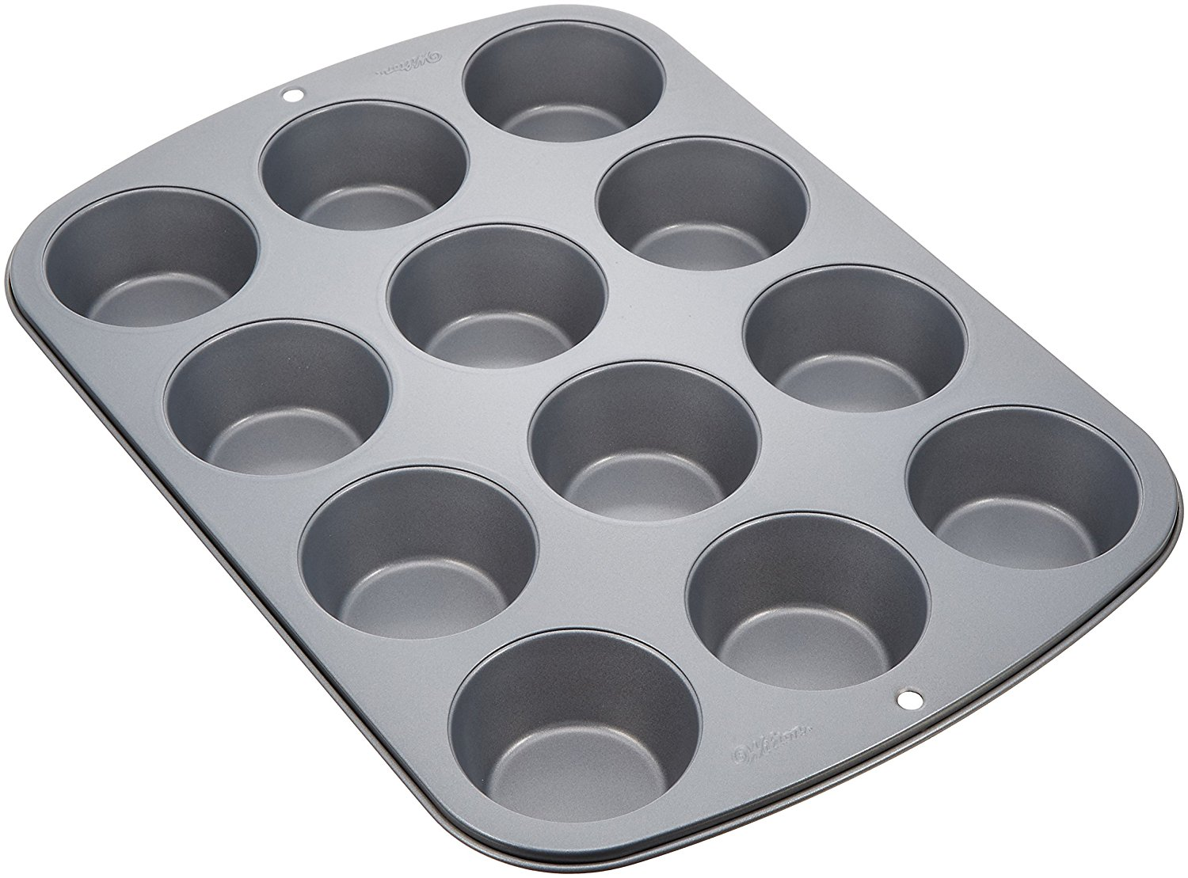

Slide 24


Slide 25
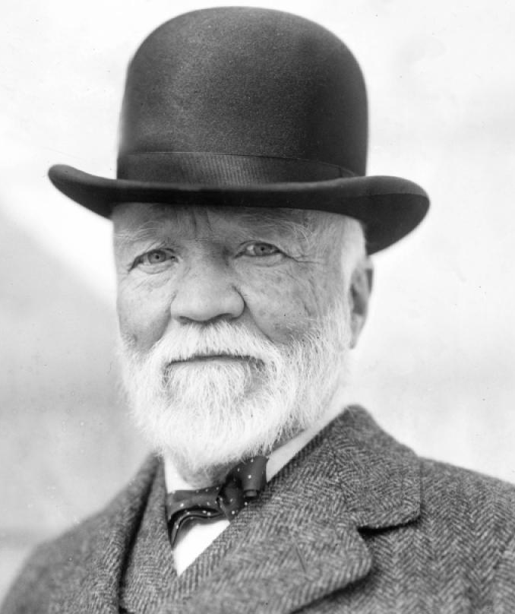
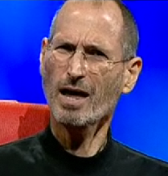
6 walnut cupcakes!
Stat!
Should be better than those apple cupcakes I made last week…

Slide 28
Group Things Together
Separate content across multiple tabs
Contain similar content on the same tabs

Slide 29
Typography in 10 Minutes
Point Size
15-25px font size
Headings 1.5x bigger than body
Line Spacing
120-140% point size
Line Length
Limit to 90 characters a line
Larger margins
Font
Professional fonts
Only use system fonts if you must

Slide 30
Self Introduction
Definition of Design
Why We Should Design
Some Examples
What Makes Good Design
How To Start

Slide 31
Logo
Title
Heading
Nav
Bar
Body
Heading
Body

Slide 33
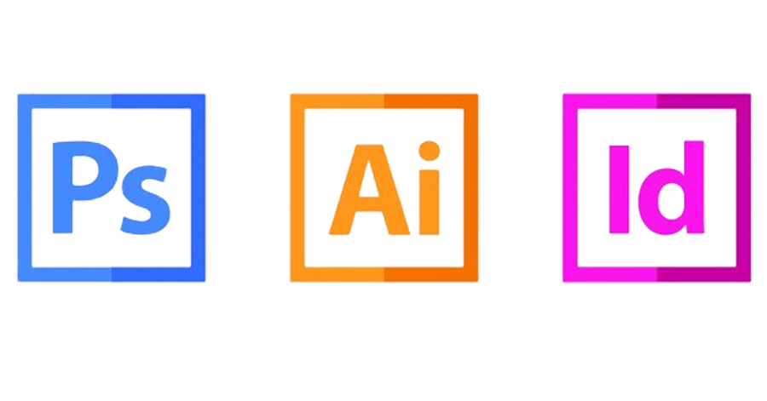
Typography
Vectoring
Planning
Photo Editing
Graphics
Design
Layout

Slide 34
